Slide 3


Speaker intro
Speaker intro
Ferran Chopo
Power Platform Advisor - Forward Forever
Ferran Chopo
Power Platform Advisor - Forward Forever
https://www.linkedin.com/in/fchopo/
https://www.linkedin.com/in/fchopo/
https://twitter.com/fchopo
https://twitter.com/fchopo
Xavi Segura​
Senior Consultant – PlanB Gmbh​
https://www.linkedin.com/in/xavisegura/
https://twitter.com/xavi_segcri

Slide 4
Agenda
Introduction - What’s Fusion Teams?
Use Case
Demo
API project to manage data stored in Azure Cosmos DB
API exposition to the internet using API Management
Create Custom Connector to connect to the API
Create a Power App that uses Custom Connector
Conclusions
Q&A: Ask us anything!

Slide 5


Fusion Teams
Effective application development depends on efficient communication of business requirements and ideas for meeting them.
The business user can quickly innovate and experiment to improve processes thanks to Power Apps and Power Automate.
In order to meet business requirements, it is often necessary to interact with existing systems for which there is no connector. This is where the professional developer comes into play.
Communication
Business User
Professional Developer

Slide 6
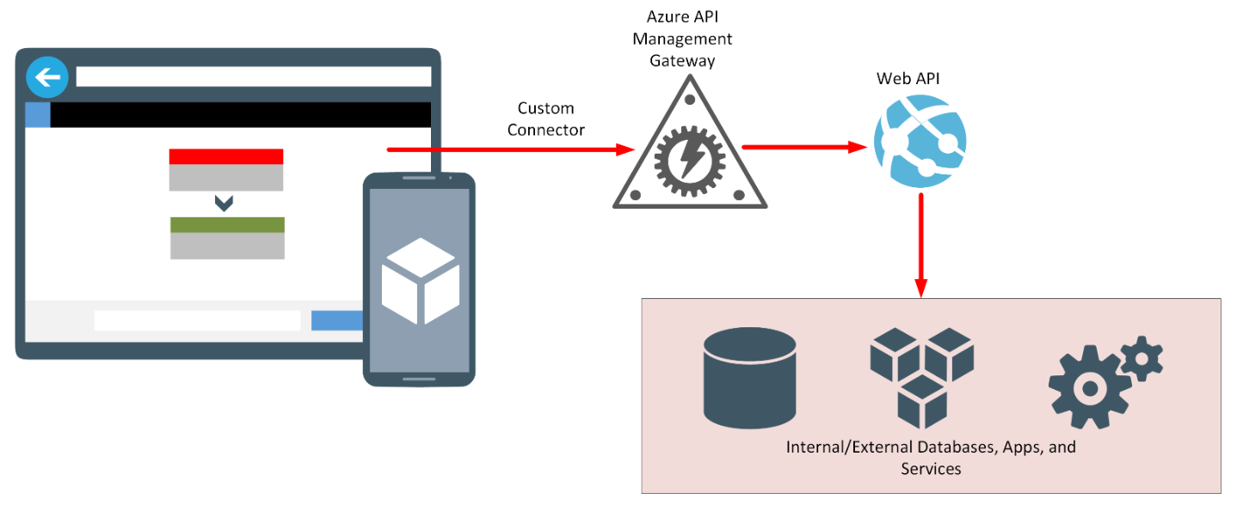
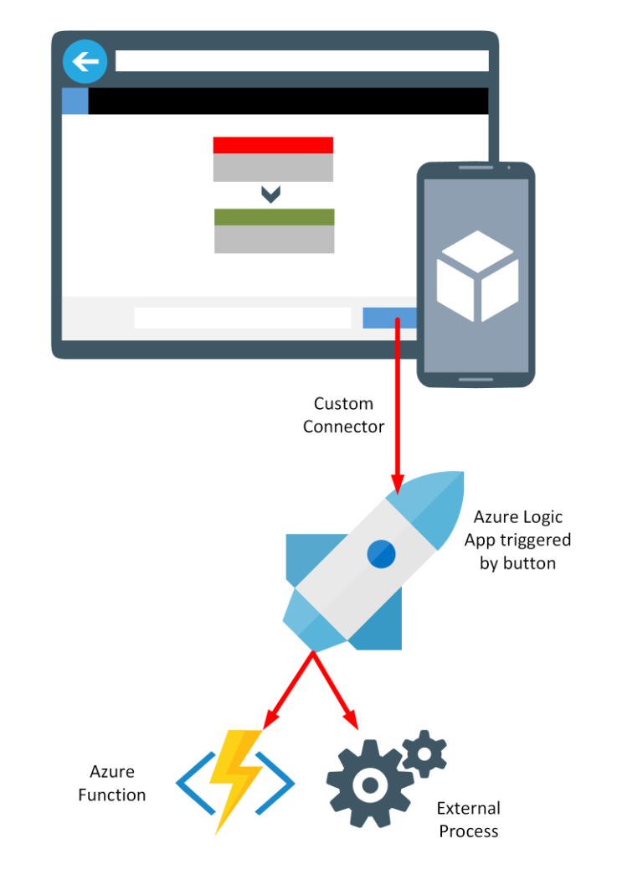
Fusion Teams
A typical use case for creating a custom connector is to allow an application access to other services and systems inside and outside the organization.

Slide 7
Use Case – Time Tracking app
Time management tool where users can allocate hours on projects.
Components:
Cosmos DB: Non-relational database where projects, resources and allocations are stored.
REST API (Net Framework): API to manage mentioned entities.
API Management: Publish and secure REST API
Custom Connector: Access the REST API methods through the APIM.
Power Apps app: It will use the Custom Connector to Create, Read, Update and Delete projects, resources and allocations.

Slide 8




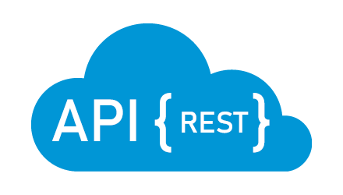


Use Case - Architecture
Time Tracking App
Custom Connector
API Management
API
Cosmos DB

Slide 9

DEMO - BACKEND
API project to manage projects, resources and allocations.
API Management to publish API to the internet

Slide 10

DEMO – Power Platform
Create Custom Connector
Power App application to connect to the API using Custom Connector

Slide 11
Q & A

Slide 12
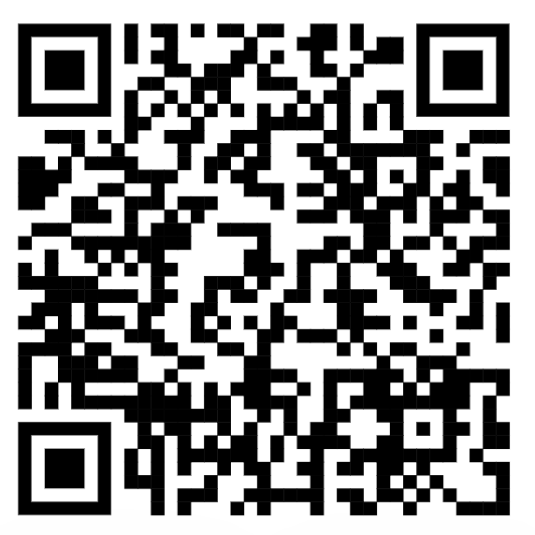
Resources
Ebook - Fusion development approach to building apps using Power Apps: https://docs.microsoft.com/en-us/power-apps/guidance/fusion-dev-ebook/
Github Repo:

